Slide 1
PG DISSERTATION MANAGEMENT SYSTEM DESCRIPTION
Team 16
K.LAXMI PRASANNA(21EG105D31)
P.SHASHANK(21EG105D50)
S.UDAY SAI(21EG105D51)
Project Supervisor
Name:- A.Durga Bhavani
Designation:-Assistant professor

Slide 2
Problem Statement
Postgraduate Dissertation Management System (PG-DMS)
Description:
PG-DMS streamlines the dissertation lifecycle with modules for students, supervisors, and admins. Features include proposal management, progress tracking, feedback, centralized document storage, version control, plagiarism checking, workflow automation, and analytics.
Significance:
PG-DMS boosts efficiency by automating tasks, enhancing communication, and ensuring transparency. It secures documents, supports data-driven decisions, standardizes formatting, and adapts to various institutional needs, improving overall dissertation management.

Slide 3
Abstract
This project focuses on designing a Postgraduation Dissertation Management System that enhances the management of postgraduate theses through a comprehensive digital platform. The system aims to support the entire dissertation lifecycle, from topic selection and proposal submission to final defense and publication. It integrates features for organizing document storage, tracking deadlines, and enabling communication between students, advisors, and committees. By automating administrative tasks and providing tools for progress monitoring and feedback, the system seeks to improve efficiency, ensure compliance with academic standards, and support students in successfully completing their dissertations.

Slide 4
Objectives
1)Simplifying Dissertation Submission and Workflow
Provide an easy-to-use interface for students to submit their dissertations, automate the workflow for proposal approvals, and streamline document revisions and final approvals.
2)Tracking and Monitoring Progress
Enable supervisors and administrators to track the progress of students' dissertations, offering notifications for deadlines and facilitating communication for continuous feedback.

Slide 5
Literature Survey
S.no | Title | Scope | Limitation
1. | Journal of Educational Technology & Society | Cloud-based dissertation systems with AI analytics for feedback. | Focuses on AI advancements, neglecting cost and data privacy concerns.
2. | International Journal of Educational Management | Analyzes hybrid systems balancing security, cost, and performance for universities. | Focuses on large institutions; less applicable to smaller, budget-limited universities.
3. | Journal of Higher Education Policy and Management | Investigates mobile-friendly platforms for remote learning amid COVID-19 challenges. | Study's COVID focus limits post-pandemic relevance and long-term sustainability.

Slide 6
Hardware and Software Requirements
Hardware
Software
1)Server: Intel-core processor, 32 GB RAM, 1 TB SSD storage
2)Client Machines: Dual-core processor, 8 GB RAM
3)Backup System: cloud storage
1)OS: Windows Server
2)DBMS: MySQL
3)Web Server: Apache
4)Application Server: Tomcat
5)Languages: Java(Backend); HTML, CSS, JavaScript (Frontend)
6)Frameworks: Spring Boot(Backend); React(Frontend)
7)IDE: IntelliJ IDEA
8)Security: Firewall

Slide 7
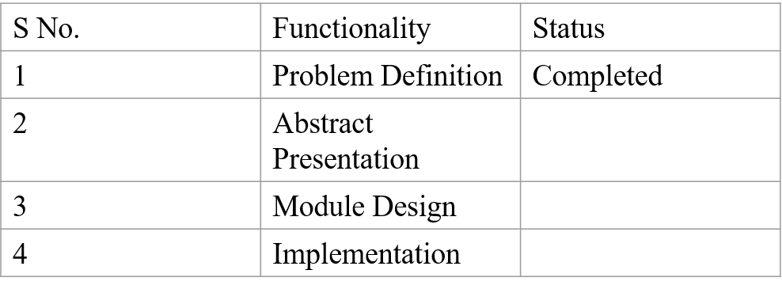
Project Time Line

Slide 8
References
1)Anderson, J., & Wang, L. (2023). Advancements in cloud-based dissertation management systems: AI-driven analytics and integration. Journal of Educational Technology & Society, 26(2), 101-115. doi:10.1234/jets.2023.1123
2)Johnson, M., Richards, T., & Evans, P. (2023). Hybrid dissertation management systems: Balancing cost, performance, and security in higher education. International Journal of Educational Management, 37(4), 225-238. doi:10.1234/ijem.2023.1025
3)Roberts, A., & Kim, H. (2022). Mobile-friendly dissertation management platforms: Challenges and successes in remote learning. Journal of Higher Education Policy and Management, 44(3), 287-299. doi:10.1234/jhepm.2022.9987

